Slide 1
I’M A CAREER SPECIALIST. Now what do I do?
Using
SCOIS
Jackie Collum
Career Specialist (Retired Spring 2020)

Slide 2

In the process of being updated
In the process of being updated

Slide 3
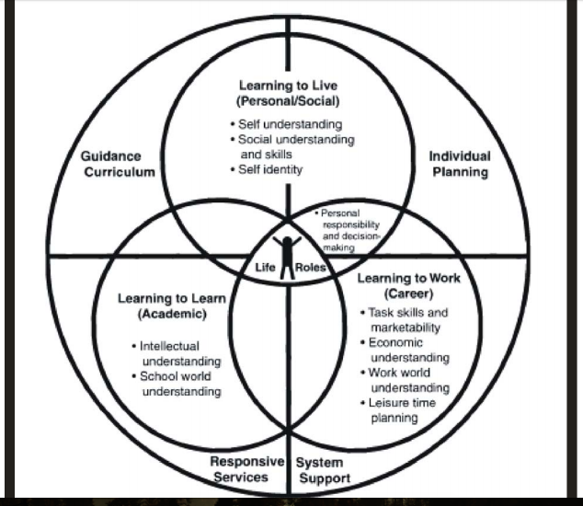

Slide 4
SOFT SKILLS
LEARNING TO LIVE
PERSONAL/SOCIAL DEVELOPMENT
CHARACTER EDUCATION

Slide 5
SOFT SKILLS
LEARNING TO LEARN
ACADEMIC DEVELOPMENT
STUDY SKILLS

Slide 6
EVERYTHING ELSE WE DO TO HELP STUDENTS GET THERE!!
LEARNING TO WORK
CAREER DEVELOPMENT
MAKING THE TRANSITION FROM SCHOOL TO WORK

Slide 7
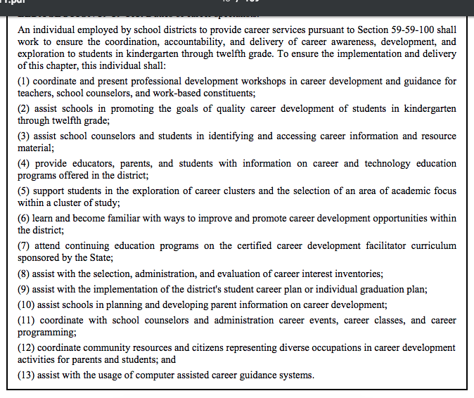
What we do!
https://ed.sc.gov/scdoe/assets/File/agency/ccr/Career-and-Technology-Education/documents/Ann4SCCDGCPM062308Finalpostedaug2011.pdf

Slide 8
Where are you going?
What will you need?
What will happen when you get there?
How do you prepare?
What roads can you take?
How much will it cost?

Slide 9
Where are you going?
16 Career Clusters Clusters
Find out about you. What are your interests?
Begin with a SCOIS assessment.
Choose some careers that interest you.
Save them to your electronic portfolio.

Slide 10
What will you need?
What classes do I need to take in high school?
What are the requirements to graduate from high school?
What’s the difference between a certificate, diploma, and a degree?
What is GPA?
What is a college entrance exam?

Slide 11
What will happen when I get there?
What will the working conditions be like?
What are some of the tasks I will have to perform?
What skills and abilities will I need?
Will there be jobs available?
How much will I earn?

Slide 12
How do I prepare?
What is my major/program of studies?
Will I need a certificate? Degree? License?

Slide 13
What roads can you take?
What is the Major/Program of studies?
Where can I study that?
What is the difference between Public and Private colleges?
In-state - versus - Out of state?

Slide 14
How much will it cost?
Tuition
Books
Extra fees
Room and Board

Slide 15
Meanwhile….in the real world
MicroCareerBurst Online Job Shadowing
Reality Check
Financial Football
Nitrotype
Roadtrip Nation

Slide 16
I’M A CAREER SPECIALIST. Now what do I do?
Jackie Collum, GCDF, CDFI, HS-BSP
Career Specialist
Jackiec1006@gmail.com
843-307-3894

